Slide 1
Database System Concepts
and Architecture

Slide 2


Data models
Schemas
Instances

Slide 3
Data Model
One fundamental approach is that it abstraction.
characteristic
of the database
provides some level of data
Data abstraction generally refers to the suppression of details of data organization and storage
Highlighting of the essential features for an improved understanding of data.
Data abstraction - Different users can perceive data at their preferred level of detail.

Slide 4
Data Models
A set of concepts to describe the structure types, relationships) of a database, and constraints that the database should obey.
(data certain
Data models also include a set of basic operations for specifying retrievals and updates on the database.
Also include concepts in the data model to specify the
dynamic aspect or behavior of a database application.
This allows the database designer to specify a set of valid user-defined operations. (COMPUTE_GPA)

Slide 5

Categories of Data Models

Slide 6
Categories of Data Models
Conceptual (high-level, semantic)
provide concepts that are close to the way many users perceive data,
Physical (low-level, internal)
provide concepts that describe the details of how data is stored on the computer storage media, typically magnetic disks.
Implementation (record-oriented)
which provide concepts that may be easily understood by end users
Representational data models hide many details of data storage on disk but can be implemented on a computer system directly.

Slide 7
Conceptual Data Model
Conceptual data models use concepts such as entities, attributes, and relationships.
An entity represents a real-world object or concept
such as an employee or a project from the mini described in the database.
world that is
An attribute represents some property of interest that further describes an entity,
such as the employee’s name or salary.
A relationship among two or more entities represents an association among the entities,
for example, a works-on relationship between an employee and a project.

Slide 8
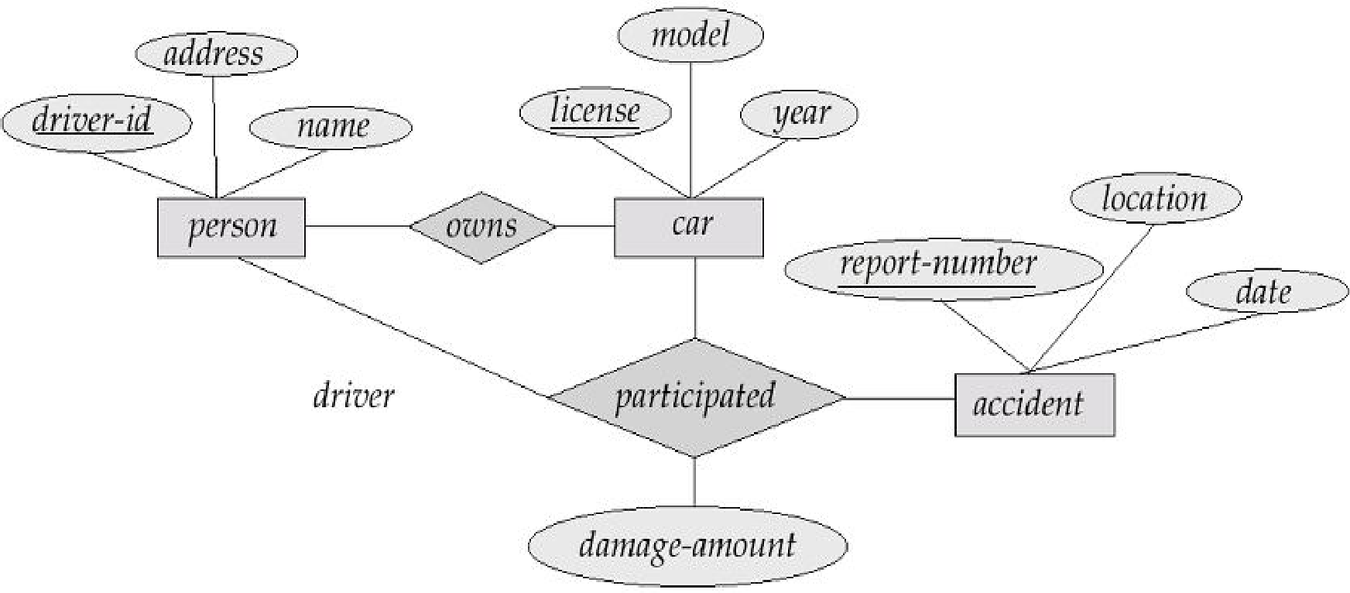
Example ER Model

Slide 9
Representational Data Model
Representational or implementation data models are the models used most frequently in traditional commercial DBMSs.
These include the so-called legacy data models— the network and hierarchical
Representational data models represent data by using record structures and hence are sometimes called record-based data models.

Slide 10
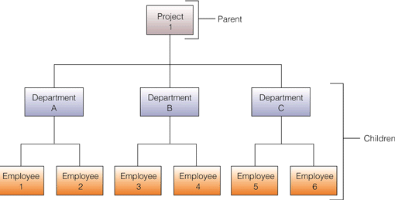
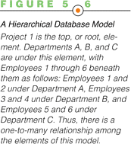
Hierarchical (Tree) Model

Slide 11
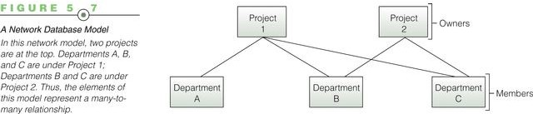
Network Model
13

Slide 12
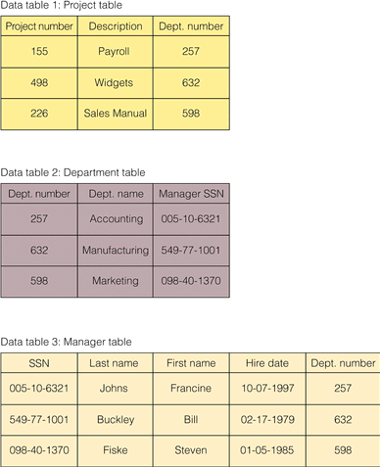
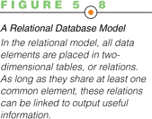
Relational Models

Slide 13
Physical Data Model
Physical data models describe how data is stored as files in the computer by representing information such as record formats, record orderings, and access paths.
An access path is a search structure that makes the search for particular database records efficient, such as indexing or hashing.
An index is an example of an access path that allows direct access to data using an index term or a keyword.
Index may be organized in a linear, hierarchical (tree- structured), or some other fashion.

Slide 14
Schemas, Instances and
Database State

Slide 15
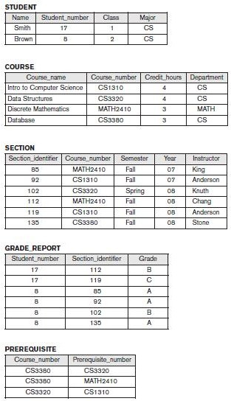
Student Database

Slide 16
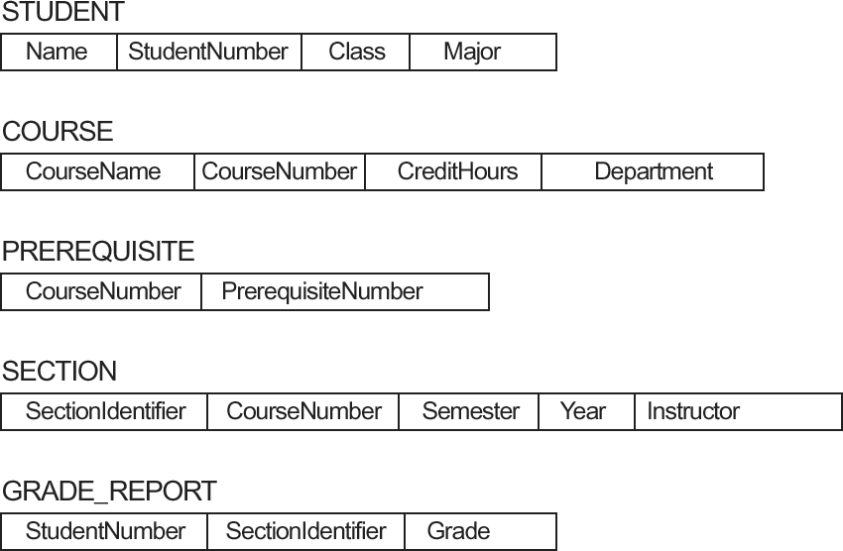
Schema diagram for the Student database

Slide 17
Database Schema
In a data model,
It is important to distinguish between
database and the database itself.
the description of the
The description of a database is called the database schema, which is specified during database design and is not expected to change frequently.
Most data models have certain conventions for displaying schemas as diagrams.
A displayed schema is called a schema diagram.
The diagram displays the structure of each record type but not the actual instances of records.
Each object in the schema—such as STUDENT / COURSE — a schema construct.

Slide 18
Schema Diagram - Limitations
A schema diagram displays only some aspects of a schema
such as the names of record types and data items
Other aspects are not specified in the schema diagram;
Figure shows neither the data type of each data item nor the relationships among the various files.
Many types of constraints are not represented in schema diagrams.
A constraint such as students majoring in computer science must take CS1310 before the end of their sophomore year is quite difficult to represent diagrammatically.

Slide 19
Database state
The actual data in a database may change quite frequently.
For example, the database changes every time we add a new student or enter a new grade.
The data in the database at a particular moment in time is called a database state or snapshot.
It is also called the current set of occurrences or instances in the database.
Every time we insert or delete a record or change the value of a data item in a record, we change one state of the database into another state.

Slide 20
Database Schema vs Database State
When we define a new database
we specify its database schema only to the DBMS.
The corresponding database state is the empty state with no data.
Get - initial state of the database when the database is first
populated or loaded with the initial data.
From then on,
every time an update operation is applied to the database
we get another database state.
At any point in time, the database has a current state.
DBMS is responsible for ensuring that every state of the database is a valid state— that is, a state that satisfies the structure and constraints specified in the schema.

Slide 21
Intension and Extension
Hence,
specifying a correct schema to the DBMS is extremely important and
the schema must be designed with utmost care.
The DBMS stores the descriptions of the schema constructs and constraints—also called the meta-data— in the DBMS catalog so that DBMS software can refer to the schema whenever it needs to.
The schema is called the intension, and a database state is called an extension of the schema.

Slide 22
Schema Evolution
The schema is not supposed to change frequently
It is not uncommon that changes occasionally need to be applied to the schema as the application requirements change.
For example,
we may decide that another data item needs to be stored for each record in a file, such as adding the Date_of_birth to the STUDENT schema.
This is known as schema evolution.
Most modern DBMSs include some operations for schema evolution that can be applied while the database is operational.

Slide 23

Client / Server Architecture
Data Model
Categories of Data Models
Schemas
Instances
Database State

Slide 24


